Slide 1
Water Metering System By
AJAY PRAJAPATI(3304) SHAILENDRA PRATAP SINGH SENGAR(3335)

Slide 2
1.
Overview

Slide 3
The water system in our country is based on monsoons. We thought about this idea based on the circumstances that Pune City faced this year. Scarcity of water!

Slide 4
Our idea WATER MATTERS revolves around the following points
Leakage
Water Mafia - Tanker Mafia and illegal pipelines
Extra Usage of water - Defaulters
Reducing labour charges
Real Time Quick Analysis - Overthrowing the old system
Checking the status of pipelines which are not working.

Slide 5
BIG CONCEPT
Our idea is based on digitalizing the old water metering system.

Slide 6
DIAGRAMS TO EXPLAIN THE IDEA
Water Flow Sensor YF-S201
Water Flow Sensor YF-S201
Water Flow Sensor YF-S201
Water Flow Sensor YF-S201
Water Flow Sensor YF-S201
Water Flow Sensor YF-S201
Water Flow Sensor YF-S201
Water Flow Sensor YF-S201
Arduino
XBEE/GSM / Wifi Module
Arduino
XBEE/GSM / Wifi Module
Arduino
XBEE/GSM / Wifi Module
Arduino
XBEE/GSM / Wifi Module
Workstation
Socket.io
Conversion into cvb file
Server and database
Water Flow Sensor YF-S201
Water Flow Sensor YF-S201
Data Analytics
Web Service

Slide 7

WANT BIG IMPACT?

Slide 8
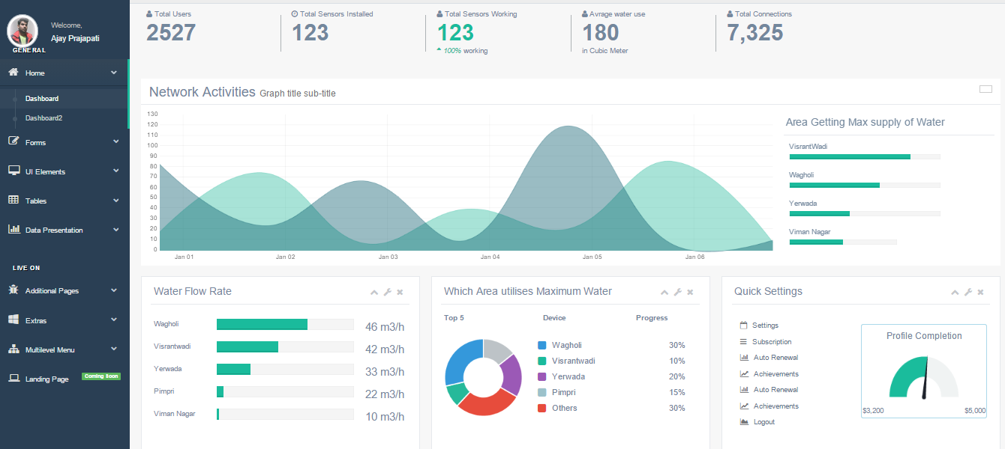
WEB APPLICATION : ADMIN PANEL
The Admin Panel is made for use by the water department which will display data of different society, pumphouse and pipelines.

Slide 9
STEPS IN THE PROJECT

Slide 10
DATA FILE PREPARATION AND PREVIEW : -
Pig being a query based system, a basic understanding of the data file is important. Before moving forward let us go through a sample of the data used for the trend analysis.
PMC | 12-08-2016 | 531.94 | 19.7 | 32212569 | 18.554975 | 73.797235
Pune Cantonment | 01-08-2016 | 13.3 | 0.54 | 505770.9 | 18.5022438 | 73.8785237
PCMC | 07-08-2016 | 239.32 | 9.58 | 2212569 | 18.6245536 | 73.8064108
The basic scheme in the above sample and the data file used in this project is:
(Administrative region), (Date), (Capacity), (Flow Rate), (Population), (Latitude), (Longitude).

Slide 11
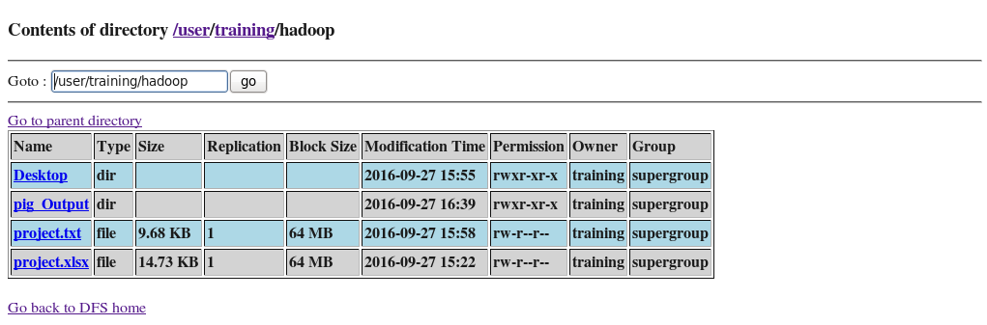
LOADING FILE INTO HDFS
hadoop fs -mkdir /user/training/hadoop
hadoop fs -put /home/training/Desktop/project.xlsx /user/training/hadoop
This command has two parts first is the path name (data/ distribution_data.csv) of the file to be put in the Hadoop file system second is the path (/user/training/) of the location where the file is to be loaded.
SNAPSHOT OF HADOOP FILE SYSTEM SHOWING TRAINING DIRECTORY

Slide 12
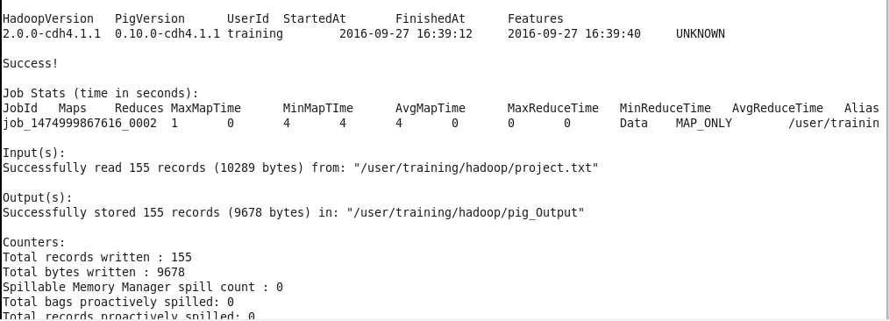
LOADING THE FILE INTO PIG
Data = LOAD '/user/training/hadoop/project.txt' Using PigStorage('\t') AS (Administrative_region:chararray,date:chararray,Capacity:float,Flowrate:float,Population:int,lat:float,long:float);
This line loads the information from HDFS into a PIG collection named Data. Pig expects data to be tab-delimited by default and as such our file is by default tab (space) delimited. Let’s say our file was semi colon “;” delimited we could have told the system that semicolons are field separators by providing colon as the delimiter.

Slide 13
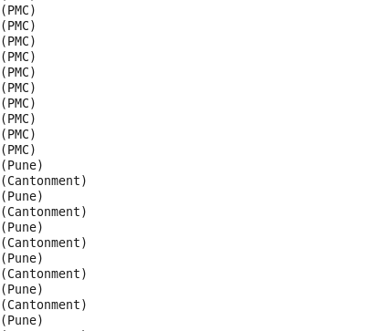
DATA PROCESSING
--extract the categories from the data group21 = foreach Data generate flatten(TOKENIZE(Administrative_region)) as t:chararray;
--group similar types of category tokens together into groups g2 =GROUP group21 by t;
--count the number of entries in each group cnt= FOREACH g2 generate group, COUNT(group1);

Slide 14

TO FIND THE AVERAGE OF DIFFERENT FIELDS
Pig has some predefined utilities like the AVG() command that can find the average of a given set of data quantities. This reduces the load on the programmer and on provides a quick and efficient alternative
Data = LOAD
'/user/training/hadoop/project.txt' Using PigStorage('\t')
AS (Administrative_region:chararray,date:chararray,Capacity:float,Flowrate:float,Population:int,lat:float,long:float);
group1 = Group Data All;
Flowrateavg = Foreach group1 generate (group1.Administrative_region, group1.flowrate), AVG(group1.flowrate);

Slide 15
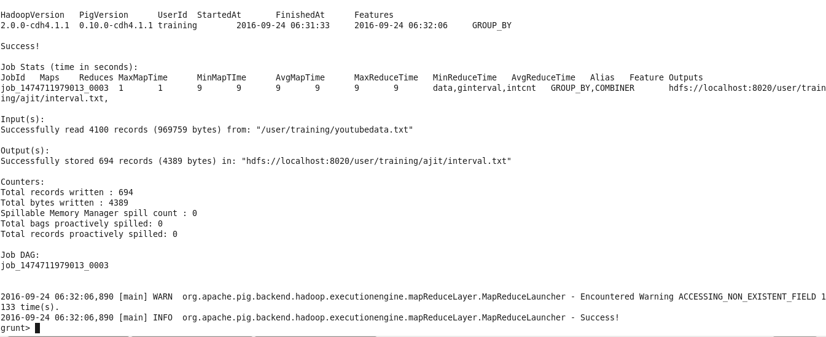
STORING THE FILE FROM PIG TO HDFS
Function: The store function. You can use a built in function. PigStorage: Loads and stores data as structured text files. PigDump: Stores data in UTF-8 format. JsonLoader, JsonStorage: Load or store JSON data. BinStorage: Loads and stores data in machine-readable format.

Slide 16
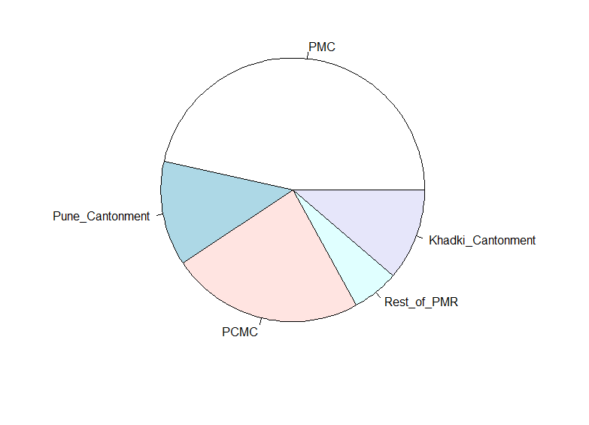
Percentage of Water Given

Slide 19
WATER REQUIREMENT VS RECEIVED GRAPH OF PMC
(IN MLD)

Slide 20
THANK YOU

